Slide 1

INHERITANCE Course Title: Programming Language II Course Code: CSE 111 Semester: Summer 2020

Slide 2

Last Lecture
Static variable
Static method
Class method

Slide 3

Today’s Lecture
Basics of Inheritance
Multilevel Inheritance
Multiclass inheritance

Slide 4
What is inheritance?
Inheritance is a golden rule and powerful feature in OOP(Object Oriented Programming)
It allows to define a Derived Class(Child Class) which takes all functionalities(attributes and methods) of the Base class(Parent Class).
Also we can add more features in the child class according to our preference.
The best mechanism to reuse a code while building a software or system is inheritance. Otherwise, There will be a number of duplicate codes which can add more complexity.

Slide 5
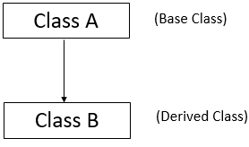

Single Inheritance
When the child class inherits the properties or functionalities of a single parent class.

Slide 6

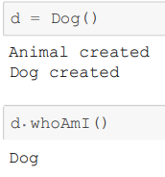
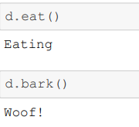
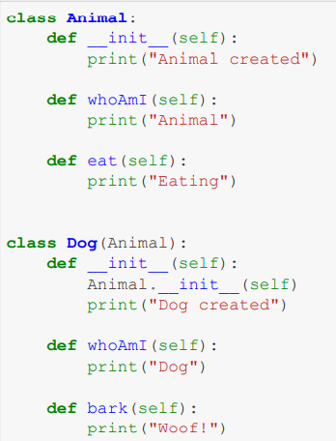
Code Example
Python Inheritance Syntax
Parent Class
(Animal)
The derived class inherits the functionality of the base class. For example, d.eat() is giving the output Eating
Dog class modifies existing behavior of its parent class i.e. the WhoAmI method of parent class which is Animal class ***
The derived class extends the functionality of the base class, by defining a new bark() method.
Child Class
(Dog)
inherits
Animal

Slide 7
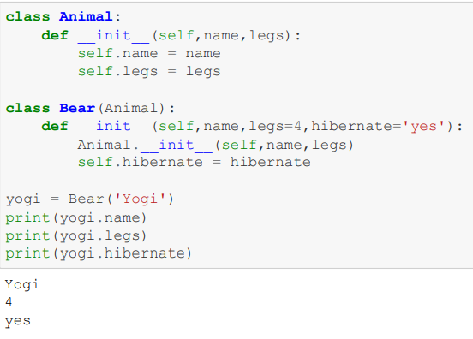
We can call the constructor of Animal class inside the constructor of child class and use it accordingly.
Code Example

Slide 8
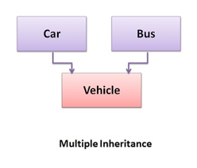
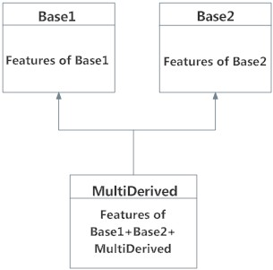
Multiple Inheritance
In multiple inheritance, the child class inherits qualities from two or more base classes

Slide 9
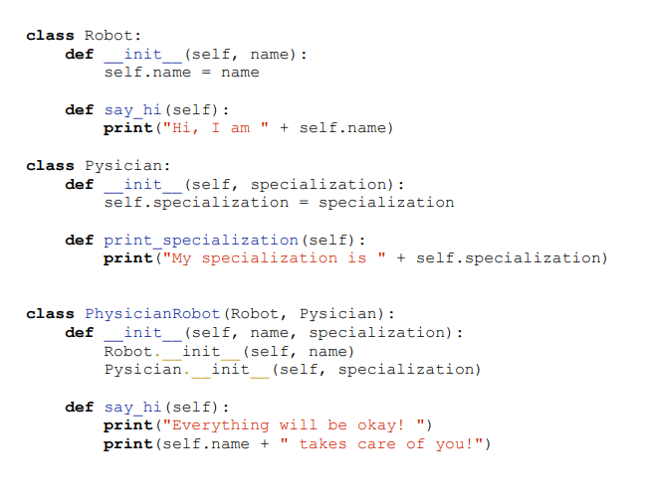
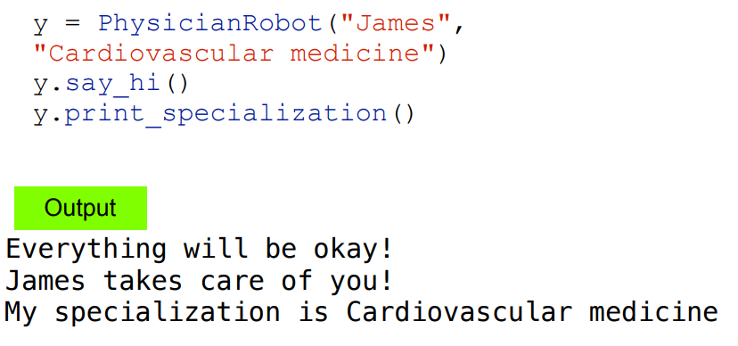
Code Example
we can call the method of Pysician class which is Print_specialization() from the object y of the PhysicianRobot class(Child)
Also PhysicianRobot(child class) modifies the say_hi() method of Robot class(Parent)
So, it can access features of both of the parent classes

Slide 10
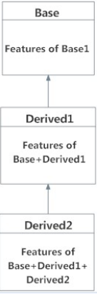
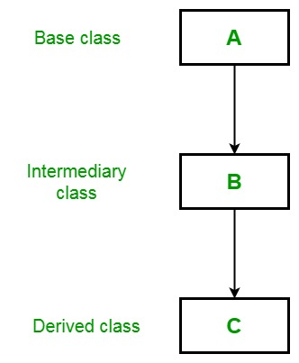
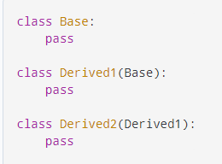
Multilevel Inheritance
Multi-level inheritance is archived when a derived class inherits another derived class.
There is no limit on the number of levels up to which, the multi-level inheritance is archived in python.

Slide 11
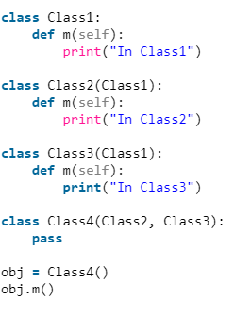



If we change Class2 like this
Output?

Slide 12
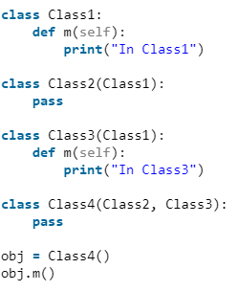
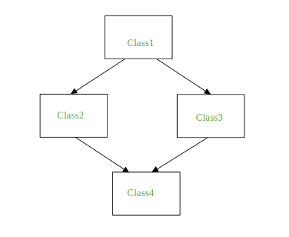
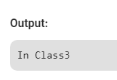
Method Resolution Order (MRO)
Things get complicated when you have several base classes and levels of inheritance. This is resolved using Method Resolution Order - a formal plan that Python follows when running object methods.
To find the output, python will travel all the parents of Class4 first (from left to right) then to the upper level parent classes (if any).

Slide 13
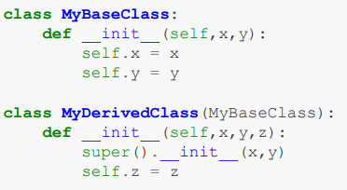
super() keyword
Python's built-in super() function provides a shortcut for calling base classes, because it automatically follows Method Resolution Order.
Note that we do not pass self to super().__init__() as super() handles this automatically.
***If the child class inherits more than one class and Super() is used inside its constructor then the constructor of the leftmost parent class will be invoked.

Slide 14

Next Lecture
Variable overriding
Method overriding

Slide 15


